Slide 1



University of Hyderabad
DIGITAL ELECTORAL SYSTEM FOR UNIVERSITY GOVERNANCE
BY
Sidhartha Ananthula - 21MCME08
T Lakshmi Sai Srivatsa - 21MCME06
Software Engineering

Slide 2


1
Abstract
Proposed Solution
Agenda
2
Design & Implementation
3
Apportioning Requirements
4
5
Conclusion

Slide 3


Abstract
Resource-intensive election nomination and voting process.
Software application to streamline the processes involved.
Eliminating the need of physical availability of the personnel.
Increased voter turnout and reduced costs.

Slide 4

Proposed Solution
Web Application to automate and simplify the steps involved in the nomination process.
Students could file nominations as candidates and track the status of their applications.
Proposer & Seconder can demonstrate their adherence to the candidate’s choice by accepting or rejecting the nomination.
Dean(s) could certify the Attendance & Academic Record of the candidates.
Election Chair could verify the Enclosures submitted by the candidate.

Slide 5
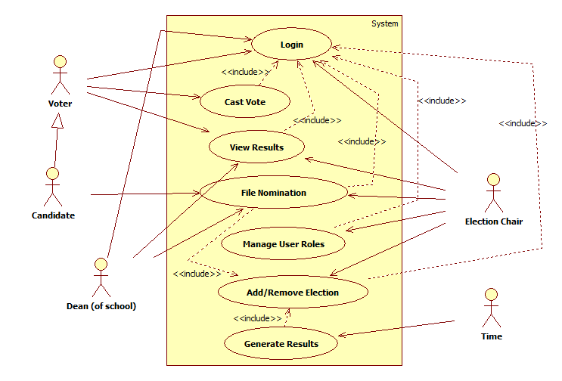
Design & Implementation
Use Case
MODEL

Slide 6
Design & Implementation
Technologies:
HTML,CSS,JS
tailwindcss
FlowBite
jQuery & AJAX
Java Server Pages(JSP)
Java Servlets
MySQL(DBMS)
System Specifications:
IntelliJ IDEA
Tomcat v10.1
Google SMTP Mail Server
Aiven Online Database

Slide 7
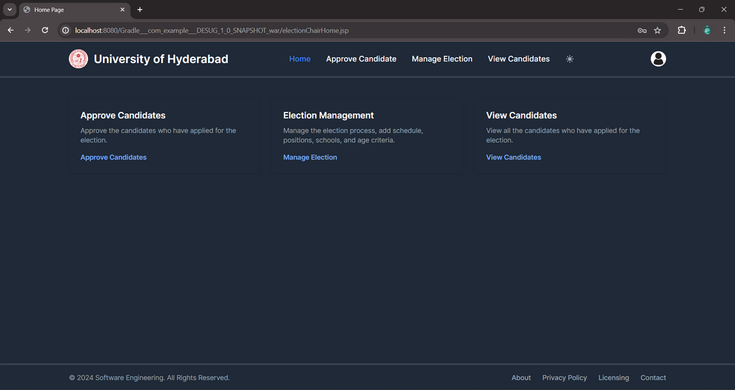
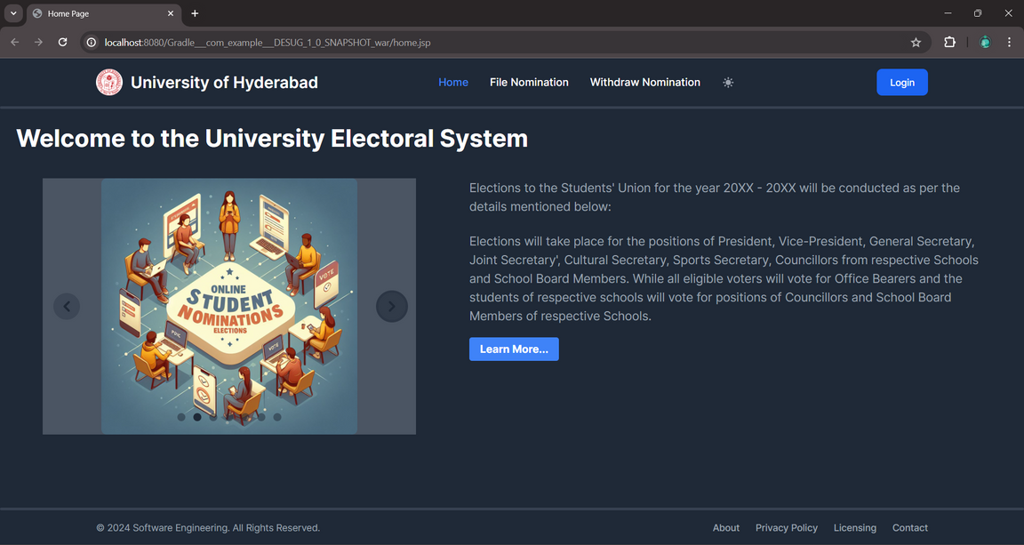
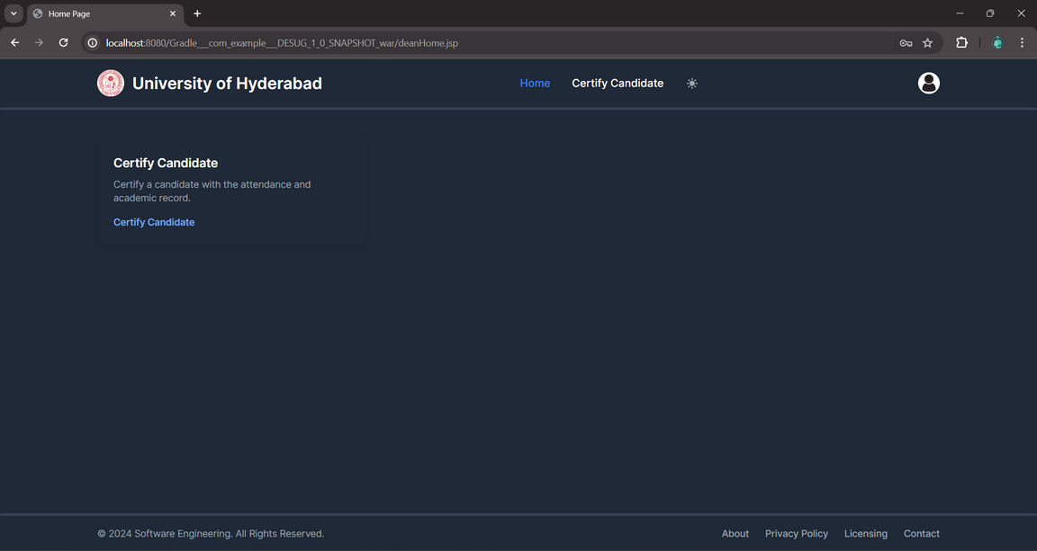
Design & Implementation
ELECTION CHAIR
HOMEPAGE
DEAN

Slide 8


Apportioning Requirements
-- Secured Voting Platform --
-- Real-time Monitoring --
-- Comprehensive Reports Generation --
-- Multiple Election Management --
And
Future Enhancements

Slide 9
Conclusion
The application provides a seamless user experience after it is fully developed.
Extend for use by any institution/organization.
References:
gadmin.uohyd.ac.in/all-notices/
www.ugc.gov.in/oldpdf/students_pdf/lyngdoh_committeemhrd2712.pdf

Slide 10
thank
you

